Slide 1
GENETIC CODE
Genetic code refers to the linear relationship between amino acids in the polypeptide chain and triplets in DNA (or RNA).
Gamow (1954) proposed that a sequence of three nitrogenous bases code for one amino acid.
Crick (1961) pointed out that three consecutive nucleotides in mRNA strand determine the position of a single amino acid in a polypeptide chain.

Slide 2
Genetic code cont’d
Nirenberg and Mathaei provided experimental evidence in support of triplet nature of genetic code.
Out of 64 codons, three are terminating codons (UAA, UAG and UGA).
Besides, there are amino acids, which are coded by more than one codon.
Only amino acid methionine and tryptophan are coded by one codon.

Slide 3
Genetic code cont’d
Leucine, serine and arginine have six different codons.
Codon AUG acts as start codon and it codes for amino acid methionine.
Codons that specify the same amino acids are called synonyms

Slide 4
Genetic code cont’d
Multiple codons for an amino acid generally show similarity in the first two nitrogenous bases and it is the third base that varies. For example, GGU, GGC, GGA and GGG code for amino acid glycine.

Slide 5
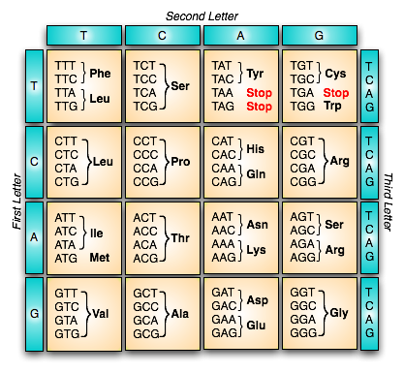
Genetic code cont’d

Slide 6
Genetic code cont’d
Dictionary of genetic code
* GUG codes for methionine, When used as initiating codon
* UAA, UAG and UGA are termination codons
The variation in the third nitrogenous base (known as wobble base) can be explained by the 'wobble hypothesis' .

Slide 7
Genetic code cont’d
The wobble hypothesis was proposed by Crick (1965), which states that the first two nitrogenous bases of the triplet codon pair according to set rule, i.e., A with U, G with C but the third base has much more freedom of pairing. The wobble base permits more than one type of pairing

Slide 8
Genetic code cont’d
Crick (1965) found that if U is present at the first position of anticodon, it can pair with A or G at the third position of codon. Similarly, G present in anticodon can pair either with C or U.
Thus, wobbling allows economy of tRNA molecule

Slide 9
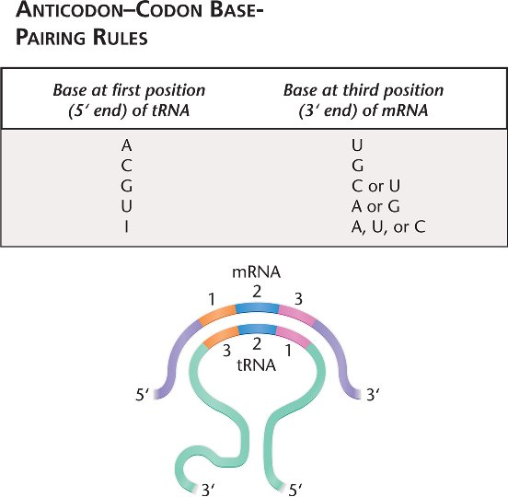
Anticodon-Codon Base-Pairing

Slide 10
Characteristics of Genetic Code
1. Triplet - Genetic code is triplet, i.e., a sequence of three nitrogenous bases in mRNA code for one amino acid.
2. Non-overlapping - Genetic code is non-overlapping, i.e., one base never participates in the formation of two adjacent codons.
3. Commaless - There is no punctuation mark between two adjacent codons, i.e., genetic code is commaless

Slide 11
Characteristics of Genetic Code
4. Universal- Genetic code is almost universal, i.e., one codon always codes for the same amino acid in all organisms.
5. Degenerate - There are amino acids, which are coded by more than one codon. Thus, genetic code is degenerate.
6. Co-linear - Sequence of nitrogenous bases in mRNA (DNA) corresponds to the sequence of amino acids in a polypeptide chain

Slide 12
Characteristics of Genetic Code
7. Initiation or Start Codon - AUG is the initiation codon, which codes for amino acid methionine. Rarely GUG acts as initiation codon.
8. Terminating or Stop Codons - Termination of polypeptide chain is brought about by specific codons called terminating codons. There are three terminating codons, viz., UAA (ochre), UAG (amber) and UGA (opal).

Slide 13
Characteristics of Genetic Code
9.Polarity - Genetic code is always read in a fixed direction, i.e., in the 5'--> 3' direction

Slide 14
Deciphering Genetic Code
Nirenberg and Mathaei (1961) synthesised RNA homopolymers comprising only one type, i.e., they produced mRNA either UUUUUU (poly-V), AAAAAA (poly-A), CCCCCC (poly-C) or GGGGGG (poly-G).
Using in vitro protein synthesis, they found the following results:
UUU codes for amino acid phenylalanine (UUU is the first code to be deciphered).

Slide 15
Deciphering Genetic Code
AAA codes for amino acid lysine.
CCC codes for proline.
However, they could not find any result with poly-G as it did not serve as a template (it attains secondary structure and thus could not attach to ribosome). Thus, three of sixty four codons were easily accounted for.

Slide 16
Deciphering Genetic Code
Further, work regarding deciphering genetic code took place by using synthetic mRNA containing two types of nitrogenous bases (heteropolymer) in the laboratories of Ochoa and Nirenberg. The synthetic mRNA contained two types of nitrogenous bases at random (random co-polymers). For example, in a random co-polymer using U and A nucleotides, eight triplets are possible-UUU, UUA, UAA, UAU, AAA, AAU, AUU and AUA

Slide 17
Deciphering Genetic Code
Theoretically, eight amino acids could be coded by these eight codons.
However, the actual experiment yielded only six amino acids-phenylalanine, lysine, tyrosine, leucine, isoleucine and asparagine, by varying the relative composition, U and A, in the random co-polymer as well as determining the percentage of different amino acids in the protein obtained

Slide 18
Deciphering Genetic Code
Lederberg and Nirenberg (1964) used cellulose nitrate filter technique for determining codons of amino acids known as the filter binding technique.
The ribosomes are left on the filter paper while tRNA washed through the filter in the absence of mRNA. But in the presence mRNA and ribosomes, the tRNAs stick to the filter.

Slide 19
Deciphering Genetic Code
A mixture of synthetic poly-U mRNA and ribosome was placed on the filter and various tRNA carrying specific amino acids labelled by 14C were separately passed through the filter.
In this process, only amino acid phenylalanine was retained in the filter. Thus, it became clear that UUU is the code for phenylalanine.
Lederberg and Nirenberg were able to determine a sequence of 54 codons out of 64 codons.

Slide 20
Exceptions to Genetic Code
Though genetic code is universal, there are a few exceptions:
1. In a few viruses, such as <pX174 and SV-40, genes are known to overlap.
2. The codons AGG and AGA, code for arginine but in human mitochondria, both these act as terminating codons.

Slide 21
Exceptions to Genetic Code
3.In Paramecium and some other ciliates, terminating codons UAA and UGA code for amino acid glutamine.
4. In Euplotes octacarinatus (ciliate), terminating codon UGA codes for cysteine. Only UAA is used as terminating codon while terminating UAG codon

Slide 22
GENE REGULATION
The process by which cells translate their genetic information contained in their DNA into proteins is known as gene expression.
These proteins have a variety of functions.
But not all these proteins are needed at a time, i.e., different proteins are required at different times.
Thus, all the functional genes do not simultaneously make protein.

Slide 23
GENE REGULATION
As the development proceeds, certain genes are activated while certain genes are suppressed.
The activation and suppression of genes at different times is called gene regulation.
Gene expressions are controlled at many levels to ensure the organism has appropriate response to its environment or internal changes

Slide 24
Gene Regulation in Prokaryotes
Gene regulation in prokaryotes is essential as they are single-cell organisms and they mainly depend on their environment for their activities.
In bacterial cells, regulation of synthesis of enzymes occurs in a way that these enzymes are produced only when substrates, which are utilised by these enzymes, are present in the cell.

Slide 25
Gene Regulation in Prokaryotes
Jacob and Monad (1961) proposed a model for gene regulation in prokaryotes, based on their study on the inducible operon system, for the synthesis of beta-galactosidase enzyme in E. coli, in order to explain the induction or repression of enzyme synthesis.
This model is popularly known as the operon model.

Slide 26
Gene Regulation in Prokaryotes
According to this model, control of gene expression in prokaryotes involves control of operon
An operon is a coordinate unit of gene expression.
Operon consists of:
1. Promoter - Promoter is the sequence of DNA where RNA polymerase enzyme binds.

Slide 27
Gene Regulation in Prokaryotes
2. Operator - Operator is the sequence of DNA where active repressor binds. It controls the activity of a number of structural genes and itself is under the control of a repressor molecule synthesised by the regulator gene

Slide 28
Gene Regulation in Prokaryotes
3. Structural Genes - Structural genes are the DNA regions that code for protein. They synthesise mRNA under the control of an operator gene.

Slide 29
Regulatory Components
1. Regulator Gene - It is the sequence of DNA that codes for the production of a repressor protein (often located away from the operon it regulates).
2. Repressor Protein - In active form, it binds to the operator to prevent transcription of structural genes

Slide 30
Inducible Operon (Lac Operon)
Inducible operons are generally in the off condition, i.e., their gene products are required occasionally or not at all by the cell.
Repressor proteins are made in active form, and are capable of binding to the operator.
Repressor proteins can be inactivated by binding to the inducer (in lac operon it is lactose) which is then activated

Slide 31
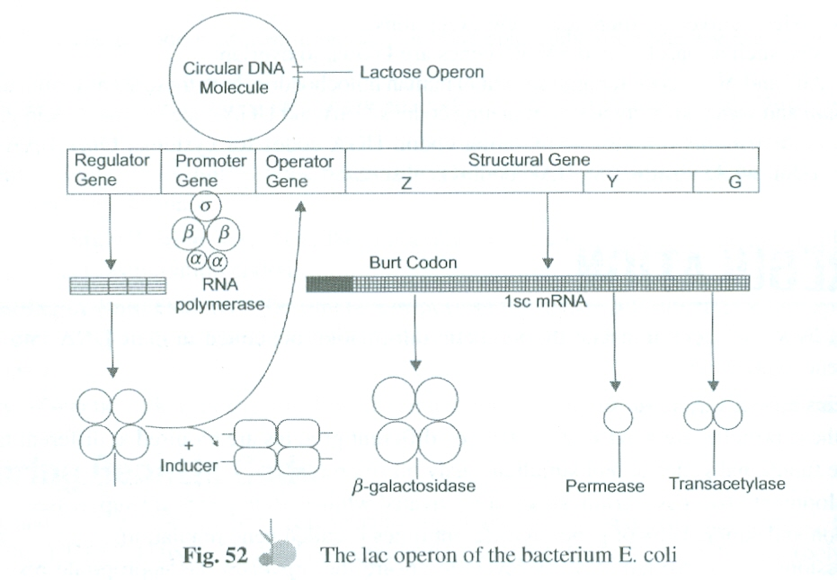
Lac Operon

Slide 32
Repressible Operon
Repressible operons are generally in the on condition, i.e., the products of genes are generally required, most of the time, by cells for maintenance.
Repressor proteins are made in inactive form, which bind to the operator.
A repressor needs to bind to a co-repressor to make it an active repressor

Slide 33
Repressible Operon
A co-repressor is generally an end product of the metabolic pathway coded by the operon. In tryptophan operon, it is tryptophan.
There must be high accumulation of co-repressor before it can bind to the repressor to make it active.

Slide 34
Negative versus Positive Controls
Above examples simply show on and off at the operator representing a negative control.
Some operons when turned on, do not transcribe at a sufficient rate, as RNA polymerase do not bind effectively to the promoter.
These operons can be transcribed effectively by binding efficient binding of RNA polymerase. An activated helper is required for RNA polymerase binding

Slide 35
Gene Regulation in Eukaryotes
Gene regulation in eukaryotes is much more complex due to their multicellularity.
In eukaryotes, regulation of gene is needed due to their cell specialisation.
Each cell type differentiates by activating a different subset of genes.
Gene regulation in higher eukaryotes may be either short term or long term

Slide 36
Gene Regulation in Eukaryotes
Gene regulation in eukaryotes occurs at the following levels:
1. Transcription
2. RNA processing
3. mRNA lifetime (longevity)
4. Translation

Slide 37
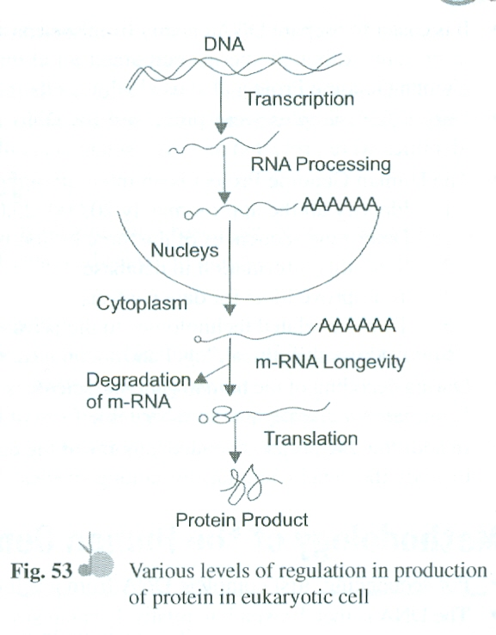
Levels of Protein Regulation

Slide 38
Gene Regulation in Eukaryotes
One of the most popular models of gene regulation in eukaryotes is the Davidson-Britten's model known as 'Gene Battery Model'. According to this model, gene regulation occurs at the level of RNA processing

Slide 39
Human Genome Project cont’d
The Human Genome Project is a mega project that was started in October 1990 and was completed in April 2003. However, the announcement of sequencing of individual chromosomes was published in 2006 with the completion of assigning nucleotide sequences to chromosomes

Slide 40
Human Genome Project cont’d
complete genetic blue- print for building a human being.
The Human Genome Project was a 13-year-effort coordinated by the US Department of Energy and the National Institute of Health. Besides the United States, geneticists from United Kingdom (Welcome Group), Japan, Germany, France, China and India also joined the project

Slide 41
Human Genome Project cont’d
The total estimated cost of the Human Genome Project would be approximately nine billion US dollars.
James Watson was the first director of the Human Genome Project. He was replaced by Francis Collins in 1993

Slide 42
Human Genome Project cont’d
Francis Collins (Director, Human Genome Project) and J Craig Venter (Founding President, Celera Genomics) are two important scientists associated with the Human Genome Project.
The complete sequence of the first human chromosome (chromosome 22) was published in December 1999

Slide 43
Human Genome Project cont’d
The human genome reference sequences do not represent gene of a particular person's genome.
The knowledge obtained from the sequences is applicable to every person as all humans share a basic set of genes and common genomic regions.
Researchers collected blood (female) or sperm (male) samples from a large number of donors

Slide 44
Human Genome Project cont’d
It is easier to prepare DNA cleanly from sperms than other cell types as sperms have a higher ratio of DNA to protein. Although sperms contained all chromosomes necessary for study, scientists involved in the Human Genome Project also used white cells from the female donor's blood

Slide 45
Human Genome Project cont’d
Only a few samples were processed for DNA resources from a large number of donors. Thus, donor identities were protected and even scientists could not know whose DNA was sequenced.
The Human Genome Project is an international scientific research project with a primary goal to

Slide 46
Primary Goal of Human Genome Project
1. Identify all the approximately 20,000-25,000 genes in human DNA.
2. Determine sequences of the three billion base pairs that constitute human DNA.
3. Store this information in databases.
4. To improve tools for data analysis

Slide 47
Primary Goal of Human Genome Project
5. Transfer related technologies to the private sector.
6. Address the ethical, legal and social issues that may arise from the project.
During decoding of the human genome, scientists also identified genes for cystic fibrosis, neurofibromatosis, Huntington's disease and an inheritable form of breast cancer.

Slide 48
Primary Goal of Human Genome Project
In addition, the project decoded genome of the bacterium E. coli, a fruit fly and a nematode worm, in order to study the genetic similarities among species. A mouse genome was also decoded

Slide 49
Methodology of the Human Genome Project
For sequencing, first complete DNA from a cell is isolated.
The DNA is then broken into relatively small sizes and cloned into a suitable host using a specialised vector.
The commonly used hosts were bacteria and yeast and the vectors were termed as BAC (Bacteria Artificial Chromosome) and YAC (Yeast Artificial Chromosome).

Slide 50
Methodology of the Human Genome Project
The cloning resulted in amplification of each fragment of DNA.
The fragments were sequenced using automated DNA sequences that worked on the principle developed by Frederick Sanger.
The sequences were then arranged on the basis of some overlapping regions.

Slide 51
Methodology of the Human Genome Project cont’d
It resulted in the generation of overlapping fragments for sequencing.
The bases in the overlapping segments were identified and assembled in a linear order, using computer database.
Throughout this process, the DNA fragments of a chromosome were sequenced to recreate its original nucleotide sequence

Slide 52
Methodology of the Human Genome Project cont’d
Such a study was conducted on all 23 chromosomes of the human genome to understand the exact genome structure of humans.

Slide 53
Salient Features of Human Genome
There are 3.1647 billion base pairs in the human genome.
The average gene size is 3,000 base pairs. Dystrophin is the largest human gene having 2.4 million base pairs.
The human genome contains approximately 30,000 genes.
Approximately 99.9 per cent base pairs are similar in all human beings.

Slide 54
Salient Features of Human Genome cont’d
The function of over 50 per cent genes is unknown.
Less than two per cent genes code for proteins.
Chromosome 1 contains 2,968 genes (maximum) while Y chromosome contains 231 genes (minimum).

Slide 55
Salient Features of Human Genome cont’d
Repeated sequences form the largest part of the human genome.
A-T rich regions have poor genes while G-C rich regions have dense genes.
Approximately 1.4 million locations have been identified by scientists in humans, where single base difference occurs (SNPs). They will help in localising the disease-associated sequences in the chromosomes.

Slide 56
Applications of the Genome Project
The project provides database information of humans. Biotechnology based company may use data to manufacture protein which are used in the treatment of genetic diseases in humans.
It helps in identifying genetic diseases.
The project will help in knowing the real bases of human life.

Slide 57
Applications of the Genome Project cont’d
By matching genome of human and Drosophila, scientists have found that Drosophila contains remedial genes for 177 genetic diseases in humans. Thus, remedy is always around us.
The action of harmful genes can be blocked by introducing antisense gene to stop genetic diseases.
Efforts are in progress to determine genes that will cause reversion of cancerous cells to normal.

Slide 58
Applications of the Genome Project cont’d
By matching genome of human and Drosophila, scientists have found that Drosophila contains remedial genes for 177 genetic diseases in humans. Thus, remedy is always around us.
The action of harmful genes can be blocked by introducing antisense gene to stop genetic diseases.
Efforts are in progress to determine genes that will cause reversion of cancerous cells to normal.

Slide 59
DNA fingerprinting
DNA fingerprinting is a technique to identify a person based on his/her DNA.
DNA fingerprinting is specific to a person and it cannot be changed by any treatment.
It is also known as genetic fingerprinting or DNA profiling.
DNA fingerprinting is a very quick way to compare the DNA sequences of two living organisms.

Slide 60
DNA fingerprinting cont’d
Sir Alec Jeffrey (1984) invented the technique of DNA fingerprinting.
99.9 per cent DNA is identical between individuals, but 0.1 per cent that differs can be used to distinguish one individual from another.
DNA fingerprinting uses a specific type of DNA sequence, known as microsatellite.

Slide 61
DNA fingerprinting cont’d
Microsatellites are short pieces of DNA, which repeat many times in a given person's DNA.
In a given area, microsatellites tend to be highly variable that make them ideal for DNA fingerprinting.
By comparing a number of microsatellites in a particular area, a person can be identified easily.

Slide 62
Technique of DNA Fingerprinting
Isolation of DNA - DNA is obtained from tissues or cells of the body. Only a small amount of tissue like blood, semen, hair, or skin is needed.
Cutting, Sizing or Storing - DNA is cut into small pieces at specific locations using restriction enzymes.
DNA pieces are sorted according to size by a process called electrophoresis.

Slide 63
Technique of DNA Fingerprinting cont’d
In electrophoresis, particles are passed through seaweed agarose gel to determine particle sizes (DNA).
Transfer of DNA to Nylon Sheet - The DNA is transferred to nylon sheet by placing the sheet on the gel and letting them soak.

Slide 64
Technique of DNA Fingerprinting cont’d
Probing - Radioactive or coloured probes are added to the nylon sheet. By doing so, a pattern is produced.
DNA Fingerprinting - This pattern is called a DNA fingerprint.

Slide 65
MOLECULAR GENETICS OF CANCER
Cancer may be defined as the uncontrolled growth of the cells (mitosis) that ultimately kills the organism.
Cancer is a combination of many diseases with different types of causes, symptoms and treatments.
Cancer cells are formed when the DNA is damaged and cannot be repaired.

Slide 66
Molecular Genetics of Cancer cont’d
Cancer is not a disease of the modern civilisation. The earliest recorded history describing cancer is between 3000 BC and 1500 BC.
If there is abnormal growth and division of cells, without any controlling limit, it results in the formation of tumours in the body.

Slide 67
Molecular Genetics of Cancer cont’d
Tumours are of the following two types:
Benign Tumour
Benign tumours are not cancerous.
They consist of well-differentiated cells.
Benign tumours can be treated easily
They do not spread to other parts of the body.

Slide 68
Molecular Genetics of Cancer cont’d
Malignant Tumour
Malignant tumours are cancerous.
They cause damage to adjacent organs by spreading cancer cells at a high rate.
The cells of this tumour invade the distant organs and form a new tumour, which has the same characteristics as the primary tumour.
They have infinite growth and are characterised by decrease in the cytoplasmic-nuclear volume ratio.

Slide 69
Classincation
Cancer is grouped, based on its origin and histology, primarily in three major types.
Carcinoma
Carcinoma is the most prominent type of cancer. It accounts for 85 per cent of all types of cancers.
Different types of carcinoma develop from epithelial tissues and are ectodermal or endodermal in origin

Slide 70
2. Sarcoma
Sarcoma is the rarest type of cancer. It is mesodermal in origin and mainly made up of connective tissue.
Different types of sarcomas are solid tumours growing from a muscle, bone or connective tissue.
All types of sarcoma account for 1 per cent of all cancers.

Slide 71
3.Leukemia and Lymphoma
Various types of these cancers comprise 7 per cent of all cancer cases.
They are grouped together because they develop in the cells of the immune system.
Types of leukemia develop in the cells of the myeloid system while types of lymphoma develop in the lymphatic system

Slide 72
Leukemia and Lymphoma cont’d
Hodgkin's disease is an example of lymphomas.
Besides the above mentioned, multiple myeloma (originates from plasma cells of the bone marrow) and mixed types of cancers are also found.

Slide 73
Characteristics of Cancer Cells
Tumour cells display characteristic set of features that distinguish them from normal cells. These traits allow the individual cell to form a tumour mass and eventually to metastasize to other parts of the body. Some important characteristics of cancer cells are as follows
1.Immortalisation - Transformed cells are immortal and can grow at an uncontrollable rate, if nutrition is available.

Slide 74
Characteristics of Cancer Cells cont’d
2. Angiogenesis - Like any living cell, tumours need blood supply for food and oxygen. Cancer cells secrete growth factors that cause nearby blood vessels to produce branches that grow into cancerous tissues.

Slide 75
Characteristics of Cancer Cells
3. Loss of Contact Inhibition - Normal cells in culture stop growing when the plasma membranes come in contact with each other. This inhibition of growth after contact is called contact inhibition. However, transformed cells lack this property and they go on dividing continuously until they kill themselves

Slide 76
Characteristics of Cancer Cells cont’d
4.Lack of Differentiation - Normally cells differentiate and become capable of specific functions (e.g., muscle cells are specialised for contraction but cancer cells are not specialised).

Slide 77
Characteristics of Cancer Cells cont’d
5. Cytoplasmic Inclusions
In transformed cells, microtubules and microfilaments are fewer in number and much thinner in comparison with normal cells.
The plasma membrane of cancerous cells contains predominantly GM) types of gangliosides but the plasma membrane of normal cells contains four types of gangliosides -GMIa, GM₁, GM₂ and GM)'

Slide 78
Cytoplasmic Inclusions cont’d
There is slow disappearance of a major protein called LETS (Large External Transforming Sensitive Proteins).

Slide 79
Cytoplasmic Inclusions cont’d
Mitochondria become swollen and the number of cristae is reduced.
The mitochondrial matrix becomes nonhomogenous.
Ribosomes and endoplasmic reticulum are abundant.
Generally, transformed cells have reduced Golgi complex

Slide 80
6. Genetic Changes
The shape and organisation of the nuclei of the cancer cell may be markedly different from the nuclei of normal cells of the same origin. This change in appearance may be useful in the diagnosis and staging of tumours.
Some cancer cells have chromosomal mutations, either extra or missing chromosomes or part of chromosomes

Slide 81
Genetic Changes cont’d
Cancer cells have extra copies of certain genes, a phenomenon known as gene amplification.
Cancer is also associated with gene mutation.
The DNA of cancer cells is different from normal cells, because they are damaged and cannot be repaired.

Slide 82
Genetic Changes cont’d
The nuclear membrane exhibits deep invaginations.
The nucleolus becomes irregular and enlarged in size due to polyploidy.

Slide 83
7. Physiological Properties
Cancer cells lack anchorage property.
Transformed cells require less amount of serum for their growth in comparison with normal cells.
In transformed cells, there is increased rate of sugar transport. This increases sugar intake by malignant cells.
In malignant cells, anodic movement is generally higher, indicating increase in negative surface charge.

Slide 84
Physiological Properties cont’d
Cancer cells are unable to oxidise NADH in the mitochondria, as they are deficient in glycerol phosphate dehydrogenase.
Cancer cells exhibit agglutination property with lectin.
Some cancer cells have defective electrical communication.
Tumour cells have high levels of protein survivin that inhibits apoptosis

Slide 85
Physiological Properties cont’d
Cancer cells often produce enzymes that help them invade neighbouring tissues. These enzymes digest the barriers to migrate and spread the tumour cells.
The mobility of surface proteins increases in the transformed cells, thus permitting easier agglutination to tumour cells by lectins.
Plasma membranes of most transformed cells contain antigens which are absent in normal cells.

Slide 86
8. Metastasis
Metastasis is one of the important characteristics of cancer cells, i.e., they have the capacity to invade other organs. A cancerous tumour may shed cells into blood and lymphatic vessels and are dispersed to distant sites where they form secondary tumours. Due to this property, it is impossible to remove them surgically.

Slide 87
Genes and Cancer
Cell division is a normal phenomenon of living organisms, which is dependent on the tightly controlled sequence of events.
These events are based on the proper levels of transcription and translation of certain genes.
Any shortage of disturbance in these processes results in unregulated growth that may lead to cancer.

Slide 88
Genes and Cancer
The genetic basis of cancer was first discovered through the work with retroviruses that were shown to cause cancer in monkeys, chicken, mice, etc.
The viral genes identified, could be directly linked to the cause of cancer in experimental animals.
The identified genes related to these processes are grouped into two categories

Slide 89
Genes whose Protein Products Stimulate or Enhance the Division and Viability of Cells
It also includes genes that cause tumour growth by inhibiting cell death. The normal version of these genes is called proto-oncogenes and their mutated or otherwise damaged genes are called oncogenes. Oncogenes lead to cancer.
Michaeal Bishop and Harold Varmus are pioneers of research on oncogenes and were awarded the Nobel Prize in 1989

Slide 90
Genes whose Protein Products Stimulate or Enhance the Division and Viability of Cells
More than 100 oncogenes have been identified and associated with some form of cancer. However, what activates these genes is not known. External factors, radiation, certain chemicals, etc., may cause activation of oncogenes and result in some types of cancer.
These genes stimulate cell growth

Slide 91
Genes whose Protein Products Stimulate or Enhance the Division and Viability of Cells
Examples:
I. MYC gene, which can result in lymphomas.
RAF genes, which can result in stomach cancer.
TRK genes, which can result in thyroid cancer

Slide 92
Activation of Proto-Oncogenes
The first oncogene was discovered in 1970 and was named Src. It was discovered in chicken retrovirus.
Proto-oncogenes are activated in the following three ways

Slide 93
(a) Gene Mutation
Gene mutation can change proto-oncogenes to oncogenes.
Such mutations can occur during normal cell division and can be caused by environmental factors such as chemicals, ultraviolet rays from the sun, X-rays and sometimes by DNA repair mechanism

Slide 94
Gene Mutation cont’d
For example, specific mutations in ras genes are frequently found in cells from varieties of tumours like colon, lung, breast and bladder cancers.
Another example of proto-oncogenes by gene mutation is RET.

Slide 95
(b) Increase in Protein Concentration Leading to Activation of Proto-Oncogenes
An increase in protein concentration may be caused by:
I. Gene duplication
An increased protein stability
An increase in protein expression

Slide 96
(c) Translocation or Amplification
Oncogenes can be activated by structural changes called translocation or amplification, which occurs in chromosomes.
During chromosome translocation, a proto-oncogene on one chromosome may move to another chromosome, leading to structural alteration of genes.

Slide 97
(c) Translocation or Amplification cont’d
For example, translocation between chromosome 9 and 22, which is found in Chronic myeloid lekumemia (CML), a proto-oncogene on chromosome 9 called c-Abl, is moved to chromosome 22, where it fuses with another gene called Bcr.

Slide 98
(c) Translocation or Amplification cont’d
Oncogenes can be activated by transposition to an active chromatin domain. In Burkitt's lymphoma (a childhood tumour, common in malarial regions of Central Africa and Pappua New Guinea), a characteristic translocation is seen between chromosomes 8 and 14. This translocation puts the MYC oncogene (located on chromosome 8) close to an immunoglobulin gene on chromosome 14

Slide 99
(c) Translocation or Amplification cont’d
Proto-oncogenes are also activated by gene amplification. For example, breast cancer amplify ERBB2 and sometimes MYC

Slide 100
Genes whose Protein Products Directly or Indirectly Prevent Cell Division
They are called tumour-suppressor genes.
Tumour-suppressor genes produce products that normally block the cell cycle, which would normally prevent the cancer.
When this gene mutates, it causes a loss or reduction in its function, leading to cancer.

Slide 101
Genes whose Protein Products Directly or Indirectly Prevent Cell Division cont’d
When mutated, the mutant allele behaves as a recessive, i.e., as long as the cell contains one normal allele, tumour suppression continues.
Because tumour-suppressor genes are recessive, cells that contain one normal and one mutated gene, i.e., heterozygous, still behaves normal (except X-linked tumour suppressor gene WTX

Slide 102
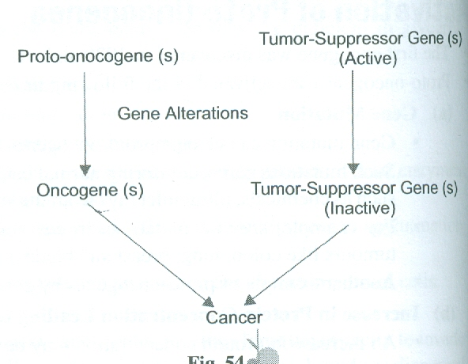
Cancer Regulation

Slide 103
Tumour-suppressor genes
1. RB Gene - It is located on chromosome 13. If RB gene becomes bad, it may result in the development of retinoblastoma, bone, breast, lung, prostrate, bladder and other cancers.
2. p53 Gene - p53 is a suppressor gene, located on chromosome 17.
It can arrest replication of cells with damaged genes until the normal process has taken place.

Slide 104
Tumour-suppressor genes cont’d
If cells with damaged genes grow and replicate, they may result in cancer.
p53 gene suppresses growth of such cells.
If this becomes bad, it may lead to the development of leukemia, breast, colon, soft tissues sarcoma and many other types of cancer

Slide 105
Tumour-suppressor genes cont’d
BRCAI Gene - It is located on chromosome 17 and if it becomes bad, it may lead to the development of breast cancer.
BRCA2 Gene -It is located on chromosome 13 and if it becomes bad, it may result in the development of breast cancer.
APC Gene - Its bad nature is associated with cancer of colon, pancreas and the stomach

Slide 106
Tumour-suppressor genes cont’d
The cancerous state results from alteration of several genes, both proto-oncogenes and tumour-suppressor genes

Slide 107
Events that cause Cancer
Carcinogens or other cancer-causing agents weaken the cell membrane and due to this weak cell membrane, a microbe is able to enter a normal cell.
The microbe, after its entry, intercepts the glucose entering the cells.
The microbe excretes myotoxins. As myotoxins are highly acidic, the inside of the cell becomes highly acidic, which is a characteristic of cancer cells.

Slide 108
Events that cause Cancer cont’d
The cell's mitochondria that convert glucose into energy, receive very little glucose as the microbe intercepts most of the glucose.
A lot of myotoxins and garbage become available to the mitochondria that they cannot convert into energy.
The mitochondria play a key role in providing energy to a cell (through the Krebs cycle and electron transport chain).

Slide 109
Events that cause Cancer cont’d
To grab more glucose, signals are sent to the insulin receptors on the cell membrane.
As a result, more glucose enters the cells. However, most of the glucose is utilised by the microbes and myotoxins increase in number.
The cell is now cancerous as its energy levels drop and it is anaerobic.
The microbes disturb the Krebs cycle and ETC as long as they are inside the cell.

Slide 110
Events that cause Cancer cont’d
Each sick cancer cell contains healthy microbes, so it is not possible to kill microbes without killing the cells

Slide 111
Carcinogens
A carcinogen is a substance capable of causing cancer or aggravating cancer in humans and animals.
Carcinogens include chemicals, radiations and some viruses.
Sir Percival Potts (1775), a British Physician primarily suggested that the induction of cancer might be linked to agents in the environments. He suggested that exposure to soot caused high rates of cancer in chimney workers.

Slide 112
Carcinogens cont’d
Most carcinogens require promoters for the production of cancer.
Benzopyrene applied on skin does not produce cancer. Croton oil when applied on skin also does not produce cancer. But when benzopyrene application is followed by croton oil, malignant growth occurs. Here croton oil acts as promoter.
Many mutagens are carcinogens but some carcinogens are not mutagens.

Slide 113
Carcinogens cont’d
Alcohol and estrogen are examples of carcinogens that are not mutagens.
The process leading to cancer by carcinogens is called carcinogenesis.
The carcinogenic potency of chemical agents depends on their ability to bind to the DNA.
It can be said that carcinogenesis is due to changes in DNA because carcinogens are mutagens

Slide 114
Carcinogens cont’d
Carcinogens are generally electron deficient, so that they can bind certain regions of the DNA through covalent linkages and induce malignant growth.
Carcinogens do not lead to cancer after every exposure.

Slide 115
Carcinogens cont’d
Some carcinogens result in cancerous changes following high-level prolonged exposure, while others may cause damage at lower levels and shorter exposure periods.
However, the genetic make-up of an individual may influence the body's response to a carcinogen

Slide 116
Carcinogens cont’d
Some potent carcinogens are aflatoxin, vinyl chloride, alkylating agents like acridine dyes and polycyclic aromatic compounds such as benzopyrene, azodyes, etc.
Besides ultraviolet radiations, sunlight is also capable of inducing malignant tumours.

Slide 117
Carcinogens cont’d
Viruses that are known to cause cancer such as HPV (cervical cancer), Hepatitis B (liver cancer) and EBV (a type of lymphoma) are all DNA viruses.
Certain parasites may also induce cancerous growth, such as Schistosoma haematobium which induces cancer of the urinary bladder.

Slide 118
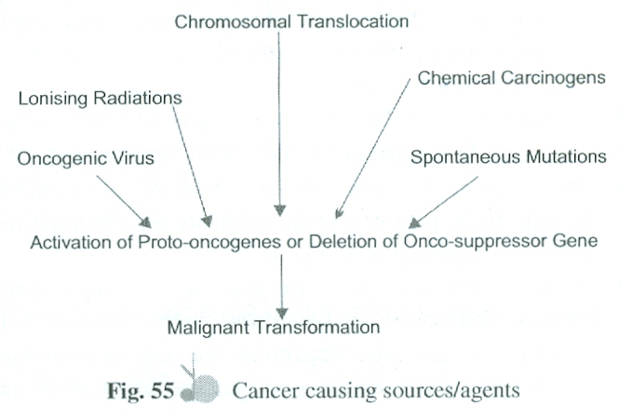
Cancer Causing Agents

Slide 119
IMMUNOGENETICS
Immunoglobulins are glycoproteins that function as antibodies.
They are found attached with the cell membrane, secretions or circulating in the blood.
They are produced in response to detection of foreign molecules in the body.
These foreign bodies that trigger the formation of antibodies are called antigens

Slide 120
Structure of Immunoglobulin
In 1962, the structure of immunoglobulin molecule was independently proposed by Rodney and Gerald Edelman, for which they were awarded the Nobel Prize in 1972.
IgG molecule is made up of two heavy chains and two light chains, joined together by disulphide bridges.

Slide 121
Structure of Immunoglobulin
In IgG, the heavy (H) chains are composed of 440 amino acids while light (L) chains are made up of 220 amino acids.
Depending on heavy chain make-up, immunoglobulin are of the following five types:

Slide 122
Immunoglobulin types based on heavy chains
IgG having y (gamma) heavy chain.
IgM having f.1 (mu) heavy chain.
IgA having a. (alpha) heavy chain.
IgD having 8 (delta) heavy chain.
IgE having E (epsilon) heavy chain

Slide 123
Structure of Immunoglobulin cont’d
Light chains are either kappa (k) or lambda (A,) in all classes.
Each immunoglobulin molecule has either kappa (k) or lambda (A,) chain but not both.
Each light chain is linked to one heavy chain and each heavy chain is associated with a light chain and with other heavy chains

Slide 124
Structure of Immunoglobulin cont’d
Both heavy and light chains contain constant (C) and variable (V) regions.
These are designated as CL and VL for light chains and VH and CH for heavy chains.
The amino acid sequence in the variable regions is highly variable.

Slide 125
Structure of Immunoglobulin cont’d
Within the V region, certain segments are observed to be more variable than other segments and are termed as hypervariable regions.
Hypervariable sequences are also called complementary determining regions (CDRs) as they form antigen-binding site complementary to the topology of the antigen structure.

Slide 126
Structure of Immunoglobulin cont’d
It is the CH region that determines the class of immunoglobulins.
The V regions determine the antigen specificity of the antibody molecule
Papain cleaves the Ig molecule, so that two Fab (fragment antigen binding) fragments and one Fe (fragment crystallisable) fragment are produced

Slide 127
Structure of Immunoglobulin cont’d
The antigen binding site is located in the Fab.
The Fe portion is not able to bind to the antigen but it contains a complement binding site which is exposed when interaction between Fab fragment and the antigen occurs.

Slide 128
Structure of Immunoglobulin cont’d
This binding occurs through noncovalent interactions (Van der Waals force, hydrogen bonds, and hydrophobic interactions) and triggers conformational changes similar to that observed in enzyme substrate interaction.

Slide 129
Immunoglobulin G (IgG)
Immunoglobulin that contains ¥ (gamma) heavy chains are called IgG.
IgG forms 70-80 per cent of the total immunoglobulins in circulation.
IgG is also known as 7SIg due to its sedimentation coefficient.
IgG promotes phagocytosis in plasma and activates the complement system.

Slide 130
Immunoglobulin G (IgG) cont’d
IgG are the only kind of antibodies that cross the placenta

Slide 131
Immunoglobulin A (lgA)
Immunoglobulins containing alpha (u) heavy chains are called IgA.
IgA is basically made up of two light chains (k or A) and two heavy chains.
IgA is the second largest class of immunoglobulins, which accounts for about 10-15 per cent of the total immunoglobulins.
They are found mainly in mucosal secretions, tears, colostrums and milk.

Slide 132
Immunoglobulin A (lgA) cont’d
They are the initial defence in mucosa against pathogens

Slide 133
Immunoglobulin M (lgM)
IgM contains mu (u) heavy chains.
IgM are also known as macroglobulins or 19S globulins.
IgM is a polymer of five immunoglobulin molecules, each consisting of two light and two heavy chains.
IgM antibodies are expanded in the surface of B cells and are formed primarily in the plasma

Slide 134
Immunoglobulin M (lgM) cont’d
These are the first antibodies produced in significant quantities against an antigen.
Natural antibodies are also IgM in nature.
Due to multivalent sites, IgM is highly effective as an agglutinating antibody.
IgM antibodies promote phagocytosis and activate complement system.

Slide 135
Immunoglobulin D
IgD contains delta (δ) heavy chains.
IgD antibodies are found on the surface of B cells that have not been exposed to antigens

Slide 136
Immunoglobulin E (lgE)
IgE contains eplsion (€) heavy chains.
IgE is present in blood in very small amounts.
Due to its cytophilic properties, it is mostly bound to cells and in circulation, it is present only in trace quantities.
IgE is a monomer and plays an important role in allergic reactions.
IgE levels increase in worm infections.

Slide 137
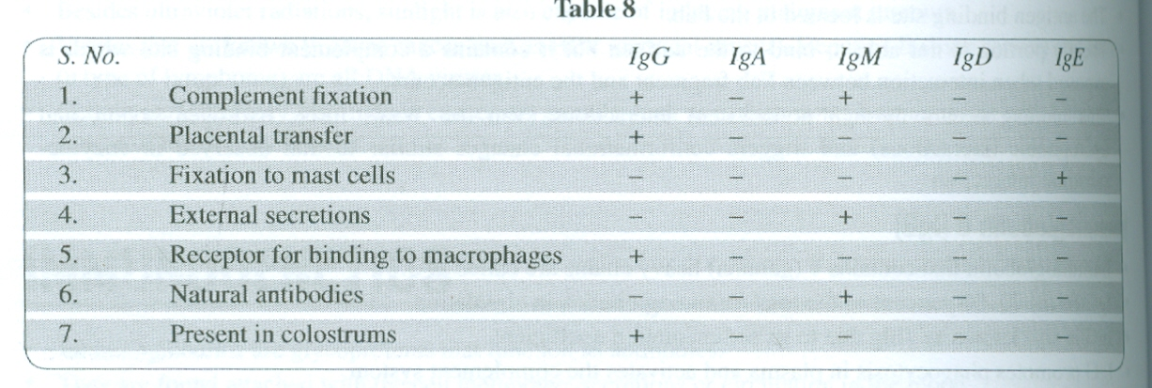
Biological properties of different immunoglobulins

Slide 138
Genetic Basis of Antibodies Diversity
The Ig molecule is a tetramer having two types of polypeptide chains, in which, one is known as light (L) chain and the other is called heavy (H) chain.
Each chain is coded by a single interrupted gene.
Any type of light chain can associate with any type of heavy chain

Slide 139
Genetic Basis of Antibodies Diversity Cont’d
Each protein chain is composed of two main regions, viz., the N-terminal variable or V region and the C-terminal constant or C region.
There exists considerable variation in sequence from one protein to another in the variable region, while constant region exhibits considerable homology among the proteins

Slide 140
Genetic Basis of Antibodies Diversity Cont’d
The V domain is generated by joining the variable regions of the light and heavy chains.
There are many genes coding for variable regions while there are only few genes coding for constant regions.
It is to be noted that neither V gene (coding for variable region) nor C gene (coding for constant region) is expressed independently

Slide 141
Genetic Basis of Antibodies Diversity Cont’d
V gene must be joined physically with C gene to form a unit in the form of a light or heavy chain.
Thus, two genes code for a single polypeptide chain.
There are three immunoglobulin gene families:

Slide 142
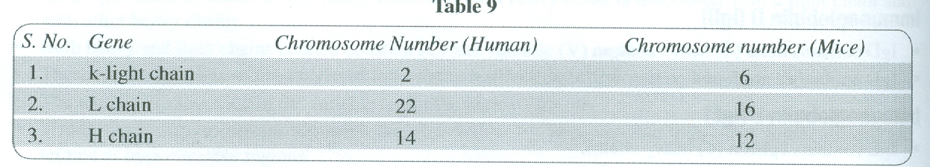
There are three immunoglobulin gene families

Slide 143
Genetic Basis of Antibodies Diversity Cont’d
The following two theories have been proposed to explain the ability of B cells to produce immunoglobulins

Slide 144
1. Somatic Variation Theory
This theory states that germ line contains a limited number of variation genes, which are diversified by mutation or recombinational events during embryonic development of the immune system

Slide 145
2. Germ Line Theory
This theory states that all the genes are inherited and antibody diversity is a result of mutations and selection.
However, neither of these theories gave a reasonable explanation of the structure of immunoglobulins.

Slide 146
Germ Line Theory cont’d
In 1976, Tonegawa and Hozumi reported the first evidence of V and C regions of immunoglobulins being encoded by different genes and the genes being rearranged in the course ofB cell differentiation.
There are about 200 different variable CV ) region genes in germ line DNA

Slide 147
Germ Line Theory cont’d
There are J 2 diversity (D) region genes and four joining (J) region genes.
Rearrangement of DNA takes place during differentiation of the cell into the B cell.
This rearrangement leads to the formation of a functional VDJ recombinant gene

Slide 148
Germ Line Theory cont’d
As any of the genes may recombine with any others, so this rearrangement has a capacity to produce 200 x 12 x 4 = 9,600 possible combinations.
Likewise, the 200 different V regions of light chains may recombine with five J regions, generating 200 x 5 = J ,000 possible light chains.

Slide 149
Germ Line Theory cont’d
Since the antibody combining site is formed from the variable region of one light chain and one heavy chain combination, the total possible immunoglobulin combinations is about 9,600 xl00 = lQ7.
In addition, variations in the precise length ofV-, D- and J-coding sequences and joints between them also lead to increase in diversity.

Slide 150
Allelic Exclusion
Like other somatic cells, B cells are diploid and contain both maternal and paternal chromosomes.
Though B cell is diploid, it expresses the rearranged heavy chain genes from only one chromosome and the rearranged light chain genes from only one chromosome.
The process by which this is done is known as allelic exclusion.

Slide 151
Allelic Exclusion cont’d
This ensures that functional B cells never contain more than one VH-DH-JH and one VL-JL unit.
It is essential for antigenic specificity of the B cell because the expression of both alleles would make the B cell multispecific.

Slide 152
Allelic Exclusion cont’d
The phenomenon of allelic exclusion suggests that once a YH-DH-JH and VL-JL rearrangement occurred, the recombination machinery is turned off leading to the suppression of expression of heavy light chain genes on the homologous chromosomes

Slide 153
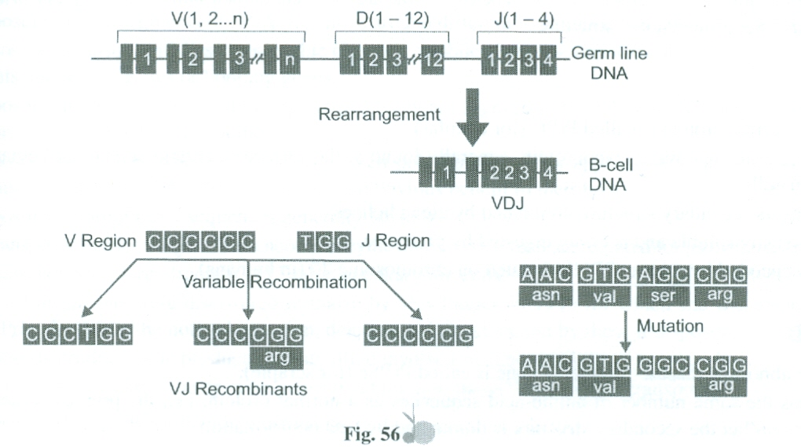
Allelic Exclusion cont’d
Allelic Exclusion cont’d

Slide 154
PRIONS
Prions are infectious agents, composed of proteins that cause fatal brain diseases.
Prions lack nucleic acid (DNA or RNA) but are yet infective, i.e., they can multiply.
A prion is a mutated protein rather than a mutated gene, which means there is a defect in the end product, and not a defect in the code.

Slide 155
Prions cont’d
Prions are 100 to 1,000 times smaller than the smallest organism and as such would be the smallest living. Form on the earth.
Prion itself is capable of modifying protein content of the entire organism.
According to recent researches, the instructions of making prion proteins are on a gene that all mammals have and is mainly active in nerve cells.

Slide 156
Prions cont’d
Prions are a product of normal human genes, termed as the PrP gene, found on chromosome 20. This gene contains two exons separated by single introns. The PrP protein is the precursor of the prion protein.
Prions do not obey the central dogma principle.

Slide 157
Prions cont’d
Two possible mechanisms have been suggested for their multiplication that violates the central dogma.
The first possibility is of reverse translation that creates a nucleic acid sequence of amino acids in PrPaod the second one is that PrP might be acting as template for its own synthesis.

Slide 158
Prions cont’d
They are rod-shaped particles and may consist of one, two or three protein molecules (Pr P).
The term 'prion' was coined by Stanley B Prusiner (1982). He received the Nobel Prize in Medicine! Physiology, in 1997, for the discovery of prion.

Slide 159
Prions cont’d
According to Prusiner, ceratin proteins come in two varieties, viz., cellular Form designated as PrPC and infectious misfold form called PrPSc. The two forms are identical in their amino acid sequences and differ in their three-dimensional structure

Slide 160
PrPC
The normal protein is called PrPC (for cellular).
It is a transmembrane glycoprotein, generally found at the surface of certain cells (e.g., hematopoietic stem cells).
It has its secondary structure dominated by alpha helices.
It is easily soluble and is easily digested by proteases.

Slide 161
PrPC cont’d
It is encoded by a gene (PRNP) located on chromosome 20 (in humans).

Slide 162
PrPSc
The abnormal disease-producing gene is called PrPSc (for scrapie).
It has the same number of amino acid sequences as a normal protein, i.e., the primary structures are identical but the secondary structure is dominated by beta conformation.
It is insoluble in all the strongest solvents and is highly resistant to digestion by proteases

Slide 163
PrPSc cont’d
When PrPSc comes in contact with PrPC, it converts PrPSc into more of itself.
These molecules bind each other forming aggregations.

Slide 164
PrPSc cont’d
According to the prion model, the disease progresses when a misfold PrPSc molecule comes in contact with cellular form PrPC . The appearance of rnisfold molecule (PrPSc) may be either spontaneous or caused by feeding an animal some food containing meat of diseased animals

Slide 165
PrPSc cont’d
Prion diseases include scrapie in sheep, mad cow disease (bovine spongiform encephalopathy or BSE) in cattle, Kuru and Cruetzfeldt-Jakob disease in humans.
BSE was first recognised in 1986, whereas Kuru had already been identified in 1957. Scrapie is known for at least 200 years.

Slide 166
PrPSc cont’d
A prion disease, also called transmissible spongiform encephalopathies, is transmissible host to host in a single species and sometimes even from one species to another. In this disease, the brain tissue is destroyed, giving it a spongy appearance

Slide 167
PrPSc cont’d
All prion diseases affect the structure of the brain or the neural tube and are universally fatal.
Prion diseases may be present as genetic, infectious or sporadic; all of which involve variation of prion protein

Slide 168
PrPSc cont’d
More than 20 mutations of the Prp gene are known to cause inheritable human prion diseases.
Like other life forms, prions have the ability to evolve through mutations and natural selection.
Prions have been discovered in fungi. It is theorised that they may playa symbiotic role in the Fungi immune system

Slide 169
PrPSc cont’d
Prions can be detected with high sensitivity by Protein Misfolding Cyclic Amplification (PMCA) technology.
On the whole, the prions are against the basic tenet that all forms of life must contain nucleic acid.

Slide 170
TRANSPOSONS
Transposons are the segments of DNA that move around different locations in the genome of a single cell.
Transposons are also termed as transposable elements, mobile elements, translocatable elements, insertion elements and selfish genes or hopping genes

Slide 171
Transposons cont’d
Transposons are also known as jumping genes as they are segments of DNA that are able to jump from location to location within a genome.
Transposons have been called selfish DNA as their only function is (or appears so) to make more copies of themselves and junk DNA because there is no obvious benefit to their host.

Slide 172
Transposons cont’d
Transposons are long DNA sequences generally 10² to 10⁴
Each transposon carries the gene that encodes enzyme transposae, which are required for its own transposition.
Transposons form a large fraction of C value in eukaryotic cells.

Slide 173
Transposons cont’d
The first transposons were discovered in maize by McClintock in 1940 for which she was awarded the Nobel Prize in 1983. She noticed insertion, deletion and translocation by these transposons.
Transposons produce gene products and are often involved in gene regulation.

Slide 174
Transposons cont’d
Larger transposons carry one or more genes in addition to those necessary for transposition.
Transposons may grow to include more genes.
In many cases transposons carry a sequence that acts as promoter, altering the regulation of genes at the site of insertion

Slide 175
Transposons cont’d
The ability of transposons to increase genetic diversity along with the ability of genomes to inhibit most transposable elements activity results in a balance that makes transposons an important part of evolution as well as gene regulation

Slide 176
Transposons cont’d
In the process of moving from location to location, transposons may cause mutations and increase or decrease the amount of DNA in the genome.
It has been estimated that 80 per cent of spontaneous mutations are caused by transposons.
Transposon elements are found both in prokaryotes and eukaryotes but are more abundant in eukaryotic genes

Slide 177
Types of transposons
There are three types of transposons:
1. Class II Transposons
Consist only of DNA that moves directly from one location to another.
2. Class III Transposons
Also known as Miniature Inverted repeats Transposable Elements (MITEs).
The genomes of rice and C. eLegans contain thousands of copies of recurring

Slide 178
2. Class III Transposons cont’d
The genomes of rice and C. eLegans contain thousands of copies of recurring motif, consisting of almost identical sequence of about 400 base pairs flanked by characteristic inverted repeats of about 15 base pairs.
The genome of rice contains about 1,00,000 MITEs.
MIETEs have also been reported in mice, humans and Xenopus

Slide 179
3. Retrotransposons (Class I)
Retrotransposons first transcribe DNA into RNA and then use reverse transcriptase to form a DNA copy of the RNA to insert it in a new location.
Many retrotransposons have long terminal repeats (LTRs) at their ends. There may be over more than 1,000 base pairs in each.
Retrotransposons also generate direct repeats at their new site of insertion.

Slide 180
3. Retrotransposons (Class I) cont’d
HIV-I and other human retroviruses (HIL-l, the human T-cell leukaemia virus) behave like retrotransposons.
The RNA genome of HIV contains one gene for transcriptase and one for integrase. The integrase serves the same function as the transposases of DNA transposons

Slide 181
3. Retrotransposons (Class I) cont’d
42 per cent of the entire human genome consists of retrotransposons.
Transposable sequences identified both in prokaryotic and eukaryotic organisms have been grouped into two categories, viz., insertion sequences and longer transposons

Slide 182
3. Retrotransposons (Class I) cont’d
Insertion sequences (IS) are short and of about 1,000 bases while longer transposons may be longer than even thousand bases.

Slide 183
Insertion Sequences
Insertion sequences are small compared with other transposable elements.
They only code for proteins involved in transposition activity.
They can insert at different regions of bacterial chromosomes and plasmid by the process of illegitimate recombination.
The coding region of an insertion sequence is generally flanked by inverted repeats

Slide 184
Insertion Sequences
Insertion sequences move by conservative transposition.
The insertion sequences (IS elements) are categorised according to form IS., where n is the number (e.g., IS" IS₂, IS) IS₄, IS,o' etc).
The mutagenic activity of IS elements is due to their insertion in the DNA and subsequent errors in the process of transcription.
IS elements play a key role in the re-orientation and joining the genetic material

Slide 185
Prokaryotic Transposons
The prokaryotic transposons are composite and noncomposite.
Composite transposons (such as Tn,o) consist of a central element, which contain several genes that provide resistance to antibiotics. It is mobilised through the activity of a transposase encoded within the insertion sequences flanking the element.

Slide 186
Prokaryotic Transposons
Certain composite transposons are flanked by two copies IS either in direct or in inverted orientation.
The frequency of transposition of composite transposons declines with increasing distance between IS sequences.
Complex transposons may be replicated by either conservative or replicative transposition.

Slide 187
Prokaryotic Transposons
Composite transposons can be easily recognised when they carry identifiable gene markers as those provide antibiotic resistance and produce toxin.
Noncomposite transposons (such as Tn)) lack insertion sequence at their extremities. They have inverted repeats necessary for transposition

Slide 188
Eukaryotic Transposons
Eukaryotic transposons were first discovered by Barbara Me Clintock for maize in the 1940s.
Most transposons found in eukaryotic cells transpose via RNA intermediates including those found in humans.
Eukaryotic transposons resemble prokaryotic transposons in many features.

Slide 189
Eukaryotic Transposons
Some important eukaryotic transposons are P elements in Drosophila melanogaster; TY elements in yeast, lAP and VL elements in rodents. The most common form of transposons in humans is the A!U sequence, which is about 300 bases long

Slide 190
Significance of transpons
Transposons:
Cause mutation and chromosomal break
May be used as genetic markers
Regulate gene expression
Form a large part of constitutive heterochromatin region of the chromosomes that are permanently condensed and for most part generally inactive in every cell

Slide 191
Significance of transpons
Some have been found to cause genetic diseases such as haemophilia, severe combined immune
deficiency, Duchenne muscular dystrophy, etc.
May be used as transformation vectors.
Used for tagging desirable genes.

Slide 192
APOPTOSIS
Apoptosis is the programmed cell death, which occurs in the life cycle of all multicellular organisms.
It is a genetically determined process.
Apoptosis regulating genes have been found in every organism.
It occurs during normal cell turnover, development and in the immune system.

Slide 193
Apoptosis cont’d
It is an active process that requires energy in the form of ATP.
It may occur when a cell has become mutated and is on the verge of becoming cancer.

Slide 194
Chief features of apoptosis
(a) Cell shrinkage
(b) Blebbing
(c) Chromatin condensation
(d) Preservation of organeJles and cell membrane
(e) DNA fragmentation
(t) Rapid engulfment by neighbouring ceJls prevent inflammation

Slide 195
Apoptosis cont’d
The term 'apoptosis' was used by Kerr et at. (1972).
Apoptosis differs from necrosis in which ceJlular debris can damage the organism.
Apoptosis involves only single scattered cells.

Slide 196
Apoptosis cont’d
In general, apoptosis is advantageous in the life cycle of an organism. For example, differentiation of fingers and toes in a developing embryo occurs because the
fingers apoptose, resulting in separation of the digits

Slide 197
Apoptosis cont’d
Excessive apoptosis may cause atrophy, such as in neurodegenerative diseases, while too less apoptosis results in uncontrolled cell proliferation in cancer.
Apoptosis is highly related with caspases, Bcl-2 proteins and granzyme B.

Slide 198
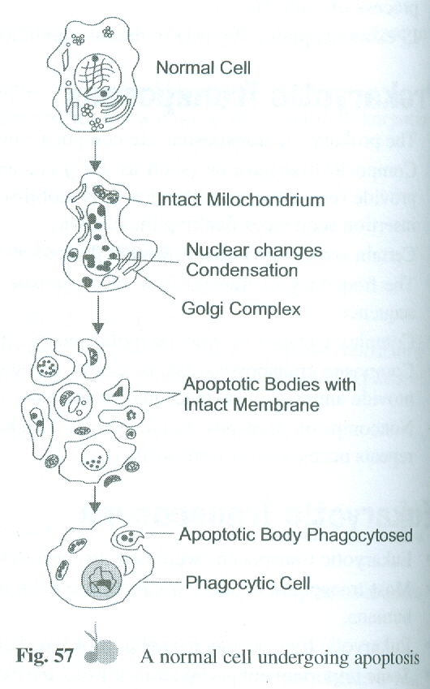
Apoptosis of Norman cell

Slide 199
Apoptosis cont’d
1. Apoptosis Triggered by Mitochondrial (Internal Signals) Pathway
Bcl-2 protein is present on the outer surface of the mitochondria of a healthy ceJl that prevents apoptosis.
Internal damage to the cell results in the migration of the Bax protein to the surface of the mitochondrion

Slide 200
Apoptosis cont’d
Here it inhibits the protective effect of Bcl-2 and it also inserts itself in the outer membrane resulting in the formation of a hole causing release of cytochrome c.
This cytochrome 'c' binds with the protein Apaf-l (apoptotic protease activating factor-I) resulting in the formation of apoptosomes.
This binding requires energy which is provided by ATP

Slide 201
Apoptosis cont’d
The apoptosomes binds with caspase-9 and activates it.
Caspase-9 is cleaved and doing so it activates caspases 3 and 7.
The activation of these caspases results in the digestion of structural proteins in the cytoplasm as well as degradation of chromosomal DNA and lastly phagocytosis of the cell.

Slide 202
Apoptosis cont’d
2. Apoptosis Triggered by External Signals
Fas and TNF receptors are integral membrane proteins.
Their receptor domains are exposed to the ce\l surface.
Binding of FasL and TNF results in the transmission of a signal to the cytoplasm that activates caspases.

Slide 203
Apoptosis cont’d
Caspase-8 activates cascade of caspase activation resulting in phagocytosis of the cell.

Slide 204
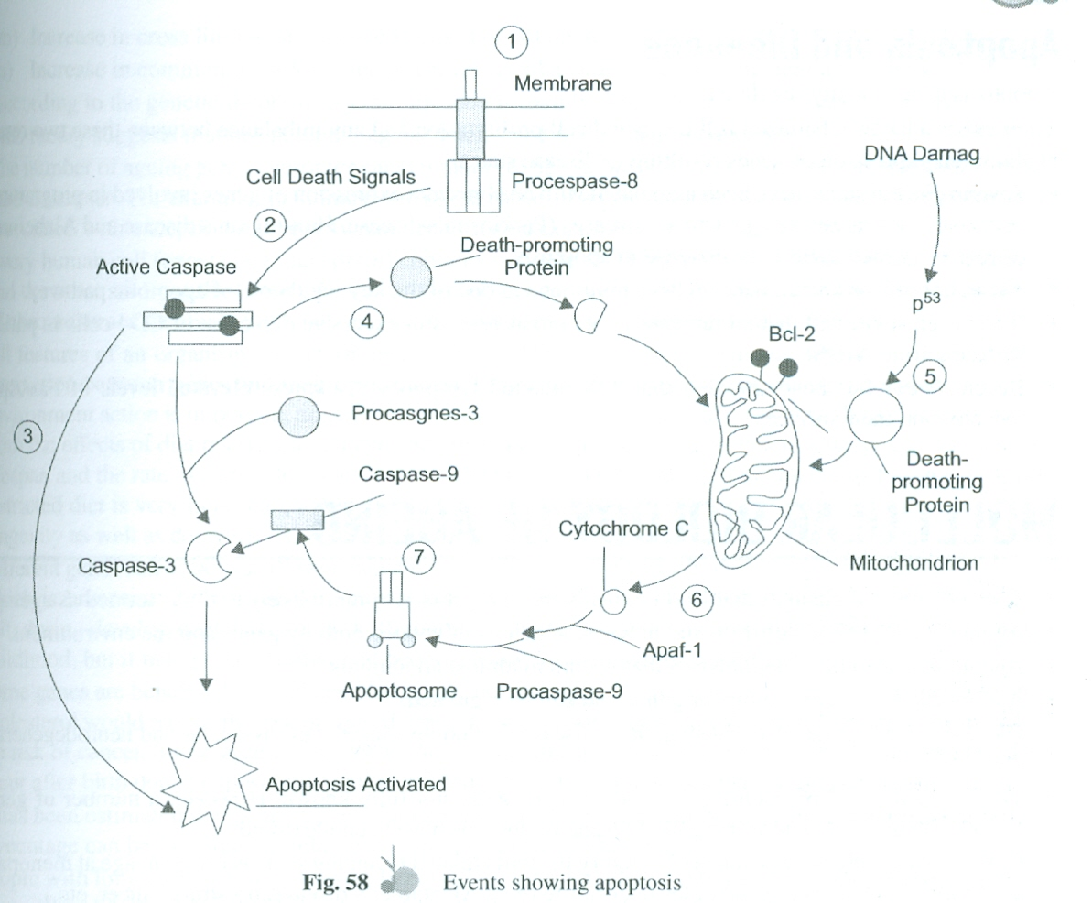
Events Showing Apoptosis

Slide 205
Apoptosis cont’d
Apoptosis-Inducing Factor (ANF)
Apoptosis-inducing factor is a protein which is generally found in the membrane space of the mitochondria.
When the cell receives a signal relating to death, the apoptosis-inducing factor is released from the mitochondria.
It then reaches to nucleus and binds with the DNA

Slide 206
Apoptosis cont’d
Binding results in the fragmentation of the DNA and ultimately death of the cell.

Slide 207
Apoptosis and Diseases
Apoptosis is genetically regulated.
There exists a balance between cell death and cell proliferation and any imbalance between these two results in abnormal expression of genes resulting in disease states

Slide 208
Apoptosis and Diseases cont’d
Several disease states have been associated with an abnormal expression of genes involved in programmed cell death such as neurodegenerative diseases (Parkinson's disease, Huntington's disease and Alzheimer's disease) in which there is an increase in apoptosis.
About half of the known cancers have mutations in one of the key regulators of apoptotic pathway

Slide 209
Apoptosis and Diseases cont’d
It has been suggested that an increase in apoptosis results in excessive depletion of CD4 cells in patients suffering from AIDS.
Recent researches have revealed that HIV-infected lymphocytes express elevated levels of Fas/Apo-I receptors on their surfaces.

Slide 210
MOLECULAR BIOL0GY OF AGEING
The collection of changes that lead human beings progressively more likely to die is termed as ageing.
Ageing is a complex multifactorial process, which is influenced both by genes and the environment.
Ageing is a universal phenomenon that occurs in almost all animals

Slide 211
Molecular Biology of Ageing cont’d
Ageing can be influenced by our genes and can be regulated.
Old age is a major factor in causing many diseases including cancer, cardiovascular and neurodegenerative diseases.
The molecular and physiological causes of ageing are not fully known. However, a number of genetic factors that assist in determining the lifespan of animals have been identified.

Slide 212
Molecular Biology of Ageing cont’d
Genetics of ageing is the science of heredity for traits related to ageing such as lifespan, age at menopause, age at the onset of specific diseases later in life (e.g., Alzheimer's disease, prostate cancer, etc.).
The genetics of ageing is closely related to the biology of lifespan.

Slide 213
Molecular Biology of Ageing cont’d
A large number of structural and functional changes occur both at cellular and tissue levels with ageing of human beings and animals. Some of these important changes are as follows:
(a) There is a progressive increase in oxidative stress.
(b) Activation of inflammatory mediators.
(c) Decrease in the number of post mitotic cells.

Slide 214
Molecular Biology of Ageing cont’d
(j) There is significant change in Apolipoprotein D gene expression (Apoplipoprotein D gene is involved in a mechanism that protects cells from ageing).
(k) DNA methylation (leading to deactivation of gene) and histone acetylation (leading to activation of dormant gene).
(I) Increase in chromosomal abnormalities and somatic mutations.
(m) Increase in cross linking and tensile strength of collagen.

Slide 215
Molecular Biology of Ageing cont’d
(e) Decrease in the levels of hormones.
(f) Decrease in the levels of certain enzymes and increase in the levels of few enzymes.
(g) Decrease in the permeability of cell membranes.
(h) Accumulation of age pigments.
(I ) Decrease in immunocompetence.
(I) Increase in chromosomal abnormalities and somatic mutations.

Slide 216
Molecular Biology of Ageing cont’d
(j) There is significant change in Apolipoprotein D gene expression (Apoplipoprotein D gene is involved in a mechanism that protects cells from ageing).
(k) DNA methylation (leading to deactivation of gene) and histone acetylation (leading to activation of dormant gene).
(m) Increase in cross linking and tensile strength of collagen.

Slide 217
Molecular Biology of Ageing cont’d
(n) Increase in common disorders such as cardiovascular disease, cancer, dementia and diabetes.
According to the genetic theory of ageing, lifespan is mainly determined by the genes we inherit.
This theory suggests that our potential age is determined at the time of conception.

Slide 218
Molecular Biology of Ageing cont’d
The number of ageing genes (gerontogenes) remains to be established. However, there are no doubts about their existence. For example, in humans one of the forms of a gene coding, apolipoprotein E (ApoEe2), is associated with exceptional longevity and decreased susceptibility to Alzheimer's disease

Slide 219
Molecular Biology of Ageing cont’d
Every human cell (except egg and sperm) contains two sets of23 chromosomes (one set from the mother and the other set from the father). However, the relative proportion of aberrant cells with unusual number of chromosomes increases with age, and the process may cause cancer and other diseases.

Slide 220
Molecular Biology of Ageing cont’d
All features of an organism are determined by genes. However, external features depend upon a complex interaction between genes and their environment, which is known as gene-environment interaction. Gene environment action is important, as gene action may be different in different conditions.

Slide 221
Molecular Biology of Ageing cont’d
It has been observed from the effects of diet restriction on mice and other species that gene-environment interactions can modify lifespan and the rate of ageing to a great extent. The proper understanding of interaction between genes and restricted diet is very important, as calorie restriction is known to be the most effective way for cultivating longevity as well as delaying age-related diseases in mammals.

Slide 222
Molecular Biology of Ageing cont’d
Different genes can be activated (switched on) or inactivated (switched off) depending on cell differentiation, which is known as differential gene expression. Gene expression may change overtime, within a given cell, during development and ageing. Differential gene expression is important for differentiation in early childhood, but it may persist further and become a key force in the ageing process

Slide 223
Molecular Biology of Ageing cont’d
Some genes are beneficial and enhance longevity. For example, a gene that assists a person in metabolising cholesterol would reduce the risk of heart disease. However, some genes are harmful, like those that increase the risk of cancer. Some gene mutations are also inheritable and may shorten lifespan. Mutations may also occur after birth due to exposure to toxins, free radicals and radiations that may cause gene changes.

Slide 224
Molecular Biology of Ageing cont’d
It has been estimated that genes can explain a maximum of 35 per cent of lifespan, while the other larger percentage can be explained in relation to environmental and hazardous factors.
People with long-lived parents are more likely to live long and identical twins (have exact the same genes) have a closer lifespan than siblings. Both these lend support to genetic basis of ageing.

Slide 225
Molecular Biology of Ageing cont’d
It has been reported that Caenorhabditis elegan (a microscopic nematode) with a specific single-gene mutation lived twice as long as members of the species that lacked this mutation (Kenyon et al. 1993).
This finding was groundbreaking for a number of reasons. First, it challenged the prevailing concept that ageing occurs as the body deteriorates over time

Slide 226
Molecular Biology of Ageing cont’d
Second, it led to a shift in thinking even among researchers, who already believed that ageing was subject to some sort of genetic control. Prior to this point, most scientists figured that ageing, age-related illnesses, and death were consequences of multiple cellular and
physiological processes and, therefore, under the regulation of a wide and diverse set of genes

Slide 227
Molecular Biology of Ageing cont’d
However, this finding suggested that a single gene could dramatically regulate how long an organism lived, thus opening the door to new hypothesis about modifying lifespan through genetic manipulation

Slide 228
Molecular Biology of Ageing cont’d
The responsible gene is called daf-2. The protein coded for by this gene (designated DAF-2) looked much like the receptor protein within humans that responds to the hormone insulin. In other words, the worm protein is simply a primitive form of our own insulin receptors

Slide 229
Molecular Biology of Ageing cont’d
The gene daf-2 is now known to regulate a number of factors in addition to ageing (like stress resistance, metabolism and development). This gene and its hormone signaling protein have been conserved evolutionarily and they are found in other animals (from fruit flies to mice).

Slide 230
Molecular Biology of Ageing cont’d
In worms and flies, the gene codes for a receptor protein that is activated by an 'insulin-like' growth factor.
This signaling pathway is analogous to the mammalian insulin pathway

Slide 231
Molecular Biology of Ageing cont’d
Scientists have reported gene p63 (a sister gene to the cancer-suppressing gene p53 that accelerated ageing in adult mice, when it was switched off).
Degradation of telomeres (pieces of DNA that cap the ends of chromosomes) is one of the possible causes of ageing. As cells divide repeatedly, their telomeres become increasingly shorter

Slide 232
Molecular Biology of Ageing cont’d
Gradually, they become so short that the cells can no longer divide. Telomeric length is now known as the marker of a given cell's age. As they shorten with each division, they cause the chromosome to fold differently, exposing a different portion of the genome. This is how a person looks different, for example, at 62 years or 2 years of age

Slide 233
Ageing and the Immune System
There are two types of immune cells, viz., B cells which produce antibodies and T cells which regulate the activities of other white blood cells.
As we age, the immune functions, particularly that of T cells tends to decline.
The ratio of various T cells is altered and the decrease in anti-inflammatory cells results in less regulation of B cells and other white blood cells.

Slide 234
Ageing and the Immune System cont’t
As a result, the tendency for self-destruction of one's tissues, known as autoimmunity, increases.
It is estimated that 10 to 15 per cent healthy older individuals have increased levels of antibodies against their own tissues

Slide 235
The Thymus Gland
The thymus gland is responsible for producing generic stem cells that can be programmed into different kinds of immune cells.
The thymus is the most active during childhood and shrinks in size with decreased production of stem cells with ageing.
There is now a widely accepted connection between ageing and immune dysfunction

Slide 236
The Thymus Gland cont’d
Besides, there is also clear evidence of information exchange between the central nervous system and the immune system.
Oxidative stress and its subsequent consequences caused by free radicals are the primary causes of ageing.
DNA damage and reduced DNA repair capability are some critical signs in considering how to live a longer healthier life.

Slide 237
GENETIC ENGINEERING
Genetic engineering is a highly specialised technique by which a DNA molecule (prokaryotic or eukaryotic) is broken at two desired places to isolate a specific DNA segment and then insert it in another DNA molecule at a desired position. The resultant DNA is called 'recombinant DNA'

Slide 238
Genetic Engineering cont’d
Using this technique, isolation and cloning of a single copy of a gene or a DNA segment into an indefinite number of identical copies has become possible. This process has become possible because bacteria, phages and plasm ids reproduce in their usual manner even after the insertion of foreign DNA.

Slide 239
Genetic Engineering cont’d
The inserted DNA also replicates faithfully with the parent DNA. This technique is called 'gene cloning'. Another technique for making millions of copies of a DNA segment of choice has been developed called 'Polymerase Chain Reaction' (PCR). In PCR, a thermo-stable
DNA polymerase (Taq polymerase) is used.

Slide 240
Genetic Engineering cont’d
The Taq polymerase is a DNA polymerase enzyme that is isolated from the bacterium Thermus aquaticus growing in the hot water springs. This enzyme acts best at noc and is not denatured at 90°C.

Slide 241
Genetic Engineering cont’d
The process of isolation, cloning and transfer of desired gene or genes in the DNA of a desired organism is called 'recombinant DNA technology'. Replication or cloning is possible only when the alien gene becomes part of the chromosome (genome) or extrachromosomal DNA (extragenomic DNA) which has its own origin of replication or 'ori'.

Slide 242
Genetic Engineering cont’d
The' ori' is present in the plasmid. The plasmids are the extra-chromosom-al, self-replicating circular DNA segment present in the bacterial cytoplasm. Cohen and Boyer (1972) first produced a recombinant DNA by attaching an 'antibiotic resistance gene' with the plasmid of the bacterium Salmonella typhimurium with the help of restriction endonuclease enzyme

Slide 243
Genetic Engineering cont’d
The restriction endonuclease enzyme cuts the two strands of the DNA double helix at a specific region that has complementary sticky ends.
The cut ends of the DNA double helix are joined together by ligase enzyme. The recombinant DNA is now transferred into E. coli bacterium where it replicates by using the host nucleotides and DNA polymerase and forms multiple copies of the DNA.

Slide 244
Tools of Recombinant Technology
Source of the donor DNA
Restriction enzymes
DNA polymerase enzyme
Ligase enzyme
Vectors
Host cell/Organisms

Slide 245
Tools of Recombinant Technology cont’d
E. coli can protect itself from the bacteriophage attack with the help of a defence mechanism called 'restriction-modification system'. The 'restriction-modification system' has two functional components, viz.,
(a) restriction enzyme and (b) methylase

Slide 246
Tools of Recombinant Technology cont’d
(a) Restriction Enzyme - It is a nuclease enzyme which recognises a specific pallindromic DNA sequence and degrades it. It is called restriction enzyme because it restricts the multiplication of bacteriophage (foreign DNA) in the bacterial cell.
(b) Methylase - The methylase enzyme adds methyl groups in the pallindromic region present in the bacterial DNA. The methylated bacterial DNA is not damaged by the action of the restriction enzyme.

Slide 247
Tools of Recombinant Technology cont’d
The restriction enzyme is also called restriction endonuclease (REN). The first discovered restriction endonuclease is Hind 1/ (from the bacterium Haemophilus infiuenzae by Smith, 1968) and the other is Ban HI (from the bacterium Bacillus amyloliquefaciens). The restriction endonuclease enzyme is of two types, viz., (a) exonucleases and (b) endonucleases

Slide 248
Tools of Recombinant Technology cont’d
The exonucleases cut the DNAIRNA molecules from the ends, whereas the endonucleases cut the DNA molecule at intercalary positions. The cut made by restriction endonucleases at specific places are called recognition sequences.

Slide 249
Tools of Recombinant Technology cont’d
The restriction endonuclease first scans the DNA, finds out the recognition sequences, attaches itself with it and then cuts both the strands of the DNA double helix at specific places through the sugar-phosphate backbone in the DNA double helix

Slide 250
Tools of Recombinant Technology cont’d
The recognition sequence is always a pallindromic sequence in the DNA double helix. The restriction endonuclease enzyme gets attached with the pallindromic sequence and cuts the hydrogen bonds between the two polynucleotide chains of the DNA double helix. Hence, it is also called molecular scissor or chemical scalpel.

Slide 251
Tools of Recombinant Technology cont’d
The cut ends of the DNA double helix are called staggered ends, sticky ends or cohesive ends.
When the DNA from different sources are cut by the same restriction endonuclease, complementary sticky ends are formed which can be joined with the DNA ligase enzyme to form a recombinant DNA.

Slide 252
Tools of Recombinant Technology cont’d
The other group of endonuclease cuts the two strands of the DNA double helix at the same place in such a way that the single-stranded DNA polynucleotide chain is not formed at the end.
The ends of the DNA double helix without single-stranded polynucleotide sequence are called 'blunt ends'. The endonuclease of this class is Sma I (from Serratia marcescens) and Sca I.

Slide 253
Tools of Recombinant Technology cont’d
The DNA is treated with restriction endonuclease to cut into small DNA fragments of different lengths. These DNA fragments are ric field by keeping it on 'agarose' (a natural polymer extracted from sea weeds Gracillaria and Gellidium) separated by Gel electrophoresis.
Gel electrophoresis is a technique of separating biomolecules under an electgel matrix.

Slide 254
Tools of Recombinant Technology cont’d
The DNA fragments are placed at the cathode end in the wells. When the electric field is activated, the negatively charged DNA fragments move towards the positively charged anode. The DNA fragments separate (resolve) according to size due to sieving effect of the agarose gel. The larger DNA fragments move slowly and the smaller fragments quickly towards the anode end.

Slide 255
Tools of Recombinant Technology cont’d
The separated DNA fragments are stained with ethidium bromide and then exposed to UV radiation; bright orange-coloured bands of DNA fragments are seen. The separated DNA bands are cut out and extracted from the agarose gel. This step is called 'elution'. The purified DNA fragments are used in constructing recombinant DNAs by attaching them to the cloning vectors

Slide 256
Cloning Vectors
Cloning vectors are the carriers or vehicles of desired DNA fragments (passenger DNA) which have the ability of independent DNA replication, to increase the number of desired genes, (e.g., plasrnids, bacteriophages).
Plasmids and bacteriophages have the ability to replicate inside the bacterial cells, independent of any bacterial genomic DNA control

Slide 257
Cloning Vectors
The bacteriophages are present in a very high number in the bacterial cell; therefore, their genomic copy number in these bacterial cells is very high. The number of plasmid in a bacterial cell is generally 1 or 2 but it may be 15 or 100 or even higher sometimes. When an alien piece of DNA is combined with the bacteriophage or plasmid DNA, the alien DNA multiplies its number equal to the copy number of the bacteriophage or plasmid.

Slide 258
Cloning Vectors
Cloning vectors are artificially designed and synthesised in such a way that they become easily linked with the alien DNA and selection of recombinants from nonrecombinants.

Slide 259
Features in Cloning Vectors
A cloning vector must have the following features:
Origin of replication (ori)
Selectable markers (for identifying recombinants from nonrecombinants)
A single recognition site for cloning

Slide 260
Types of Cloning Vectors
Cloning vectors are of the following four types:
Plasmids
Viruses
Cosmids
Artificial chromosomes
Plasmid vectors for plants are different from others

Slide 261
Types of Cloning Vectors cont’d
The best-known and commercially available vectors are pBR-322 and pUC-18. Both of these plasmids are modified natural plasm ids of E. coli. The pUC series of plasmid vectors are named so because they were initially developed in the University of California. The plasmid pUC are derived from pBR-322. The plasmids are about 2,700 bp (base pair) long.

Slide 262
Amplification of Gene of Interest using PCR (Polymerase Chain Reaction)
Mullis (1985) developed the technique of Polymerase Chain Reaction (PCR). PCR is the invitro synthesis of multiple copies of a gene or desired DNA segment. In PCR, two sets of small, chemically synthesised oligonucleotide primers, which are complimentary to the DNA part and a thermo-stable DNA polymerase (Taq polymerase), are required.

Slide 263
Amplincation of Gene of Interest using PCR (Polymerase Chain Reaction)
Taq polymerase is obtained from the hot spring bacterium Thermus aquaticus. PCR has the following three steps:
1. Denaturation
2. Annealing
3. Extension

Slide 264
Amplincation of Gene of Interest using PCR (Polymerase Chain Reaction) cont’d
1. Denaturation - The target DNA double helix is heated at about 94°C, which causes separation of the two polynucleotide chains of the DNA double helix. The separated DNA helices act as templates.

Slide 265
Amplincation of Gene of Interest using PCR (Polymerase Chain Reaction) cont’d
2. Annealing - The pairing or hybridisation of oligonucleotide primers with each of the single-stranded DNA templates at its 3' end is called annealing. Annealing is done at low temperatures (at n°C) with the addition of Taq polymerase, deoxynucleoside triphosphates and Mg++ ions.

Slide 266
Amplincation of Gene of Interest using PCR (Polymerase Chain Reaction) cont’d
3. Extension - The synthesis of new DNA polynucleotide chains, complementary to the template DNA strands, with the help of Taq polymerase is called extension. This process is repeated and after every time the amount of DNA is doubled. The amplified DNA segment is ligated with the vector to form recombinant DNA (rDNA).

Slide 267
Bioreactors
Bioreactors are large cylindrical metal containers, of 100 to 1,000 litres capacity, with a curved base for better mixing of contents. In bioreactors, the raw materials are biologically converted into specific products, individual enzymes, etc., using microbial plant, animal and human cells.

Slide 268
Bioreactors cont’d
In bioreactors, the optimum growth and development conditions (temperature, pH, substrate concentration, salts, vitamins, water content and oxygen) are provided to obtain the desired product.

Slide 269
Downstream Processing
The process of separation and purification of useful product from the fully grown genetically modified cells is called downstream processing. The product is formulated with suitable preservatives. The formulation undergoes clinical trials to know its uses and any immediate or long-term adverse effect like drugs. The formulated product also undergoes strict quality control testing.

Slide 270
Biotechnology and Its Application
Plants, animals, bacteria and fungi with genetically modified genes or DNA are called genetically modified organisms.
In Agriculture
Bt Cotton
Some strains of the bacterium Bacillus thuringiensis produce protein crystals during a particular stage of their growth, which is toxic to certain insects

Slide 271
Biotechnology and Its Application cont’d
This genetically modified cotton plant is named Bt cotton. Bt cotton plants are resistant to the cotton bollworm due to the presence of two cry genes that produce toxic cry proteins. The cry gene crylAb has been incorporated into the Bt corn plant to protect it from corn borer

Slide 272
Pest Resistant Plants
Nematodes are common parasites, which infect a number of plants, animals and human beings. A nematode Meloidegyne incognitia causes root-knot disease in brinjals, tomatoes and tobacco. The parasitic nematode drain a lot of nutrients from the host plant, and cracks develop in the roots which lead to secondary infections.

Slide 273
Pest Resistant Plants cont’d
Water and mineral absorption are impaired which leads to great reduction in crop yield. The process of RNA interference (RNAi) introduced resistance in these plants. RNA interference (RNAi) is a technique of inhibiting the activity of a gene through production of sense and antisense RNAs. The two RNAs produce a double stranded RNA (dsRNA) which undergoes fragmentation and forms short segments called short interference
RNA (siRNA).

Slide 274
Pest Resistant Plants cont’d
The short interference RNA (siRNA) binds with the mRNA, and forms silencing complex, which cleaves the mRNA having complementary base sequence and makes the mRNA silent by stopping translation. The source of this complementary RNA may be an infection by viruses having RNA genome or mobile genetic elements (transposons) which replicate through an RNA intermediate.

Slide 275
Hirudin
Hirudin is a protein that prevents blood clotting. Natural source of Hirudin protein is cattle leech (Hirudinaria). Gene coding for Hirudin protein was artificially synthesised and introduced in the Brassica napus (Rapeseed) plant

Slide 276
Hirudin cont’d
The transgenic Brassica napus (Rapeseed) plant synthesises the Hirudin protein in its cells and the Hirudin accumulate in the seeds in larger quantities. The Hirudin from the seed is extracted, purified and used as medicine (as an anticoagulant in surgery and dialysis). The transgenic product Hirudin is of great interest.

Slide 277
Genetically Engineered Insulin or Humulin
Insulin is a hormone secreted by pancreas. It is essential for maintaining the glucose-glycogen balance in the human blood. The reduced secretion of insulin leads to an increase in the glucose level in the blood because the cells fail to take up glucose from the blood.

Slide 278
Genetically Engineered Insulin or Humulin cont’d
The resultant disease is called diabetes mellitus-type II. The disease can be treated by regular and small injection dose of insulin. The insulin used for diabetes was extracted from the pancreas of slaughtered cattle and pigs. This animal source insulin (protein) caused allergy or some other type of reactions in some diabetic patients

Slide 279
Genetically Engineered Insulin or Humulin cont’d
Structurally the insulin, a protein hormone, is made up of two short polypeptide chains, viz., chain A and chain B, which are linked by disulphide bonds. In mammals, including human beings, the insulin hormone is synthesised as a pro-hormone, which is processed to become fully mature and functional hormone after releasing the extra polypeptide chain called C peptide

Slide 280
Genetically Engineered Insulin or Humulin cont’d
The C peptide is not present in the mature insulin. In
1983, a US company Eli Lilly, first prepared the two separate DNA sequences corresponding to polypeptide chain-A and chain-B of human insulin by recombinant DNA (rDNA) technology and introduced it in the plasmids of E. coli to synthesise insulin. Chain A and chain B were synthesised separately, extracted and joined by creating disulphide bond to form human insulin.

Slide 281
Biopatent cont’d
Biopatent is an official right granted by a government to an inventor or agency or an organisation. It is the sole right for commercial production, marketing and selling a particular biological material for a certain period. This right prevents the others from commercial use of the invention or product prepared by a patent holder.

Slide 282
Biopatent cont’d
Biopatent is done for the commercial exploitation of the following:
(a) Strains of microorganisms
(b) Cell lines
(c) Genetically modified plants and animals
(d) DNA sequences
(e) Protein encoded by DNA sequences
(f) Biotechnological methods
(g) Products and their applications

Slide 283
Biopiracy
Patenting and exploitation of biological resources by other countries, multinational companies and other organisations without proper authorisation, benefit sharing agreement or compensatory payment to the countries and people concerned.

Slide 284
GENETICS OF BACTERIOPHAGES
Bacteriophages are viruses that infect bacteria.
They are also known as bacterial viruses or phages.
The phages possess dsDNA, ssDNA, dsRNA or ssRNA as genetic material.
Bacteriophages were discovered by F W Twort (1915) and de Herelle (1917).
The term 'bacteriophage' was given by de Herelle.

Slide 285
GENETICS OF BACTERIOPHAGES CONT’D
Bradley (1967) categorised Bacteriophages on the basis of their morphological structure.
Each kind of bacteriophage infects a particular species of bacteria.
Bacteriophages are the most thoroughly and well-understood viruses.

Slide 286
GENETICS OF BACTERIOPHAGES CONT’D
Bacteriophages have proven to be a valuable scientific research tool for a variety of applications such as models for study of viral infections mechanisms, as tools of biotechnology that introduce new genes into bacterial cells, etc.
Three common forms of bacteriophages are known; these are tailed, cubic and filamentous.
The tailed bacteriophages form the largest group and have been studied in detail.

Slide 287
Structure of Bacteriophage
A typical bacteriophage (T₄) consists of three distinct parts, viz., head, neck and tail.
Head
Head is polyhedral in shape. In many cases, it is icosahedral.
Head is covered with a protein covering called capsid.
The capsid contains the nucleic acid.

Slide 288
Structure of Bacteriophage cont’d
The nucleic acid may be single stranded or double stranded, linear or circular in most phages.
Some phages may have linear RNA with one or more proteins.
<p6 bacteriophage contains three double-stranded linear RNA molecules with variable base sequences.

Slide 289
Structure of Bacteriophage cont’d
The protein coat protects nucleic acid from nucleases during phage infection.
In the simplest phages, nucleic acid code for 3-5 gene products while in complex phage it may code for lOO gene products

Slide 290
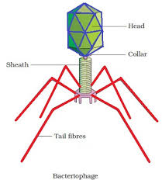
Bacteriophage

Slide 291
Neck
Neck of bacteriophages is very short and has a collar.
Neck connects head with tail.

Slide 292
Tail
Tail is a complex multicomponent structure.
Tail contains a central hollow core through which nucleic acid passes into the host cell during infection.
Tail is surrounded by a contractile sheath.
The sheath has the ability to contract longitudinally.

Slide 293
Tail cont’d
The tail end of a bacteriophage is attached to the end plate, which is hexagonal.
The endplate terminates into tail fibres.
The tail fibres are involved in the attachment of the phages to the bacterial cell.
The process by which the tail attaches to the surface of bacteria is called adsorption.

Slide 294
Tail cont’d
Some phages lack endplate and tail fibres.
On the basis of their interaction with the host bacterium, the phages are divided into two groups, viz., virulent and temperate.

Slide 295
Virulent phages
Virulent phages are those that normally lyse (destroy) the attached host/bacterial cells; there is probably no alternative strategy for their multiplication. This characteristic growth of virulent bacteriophages is called 'lytic cycle' (e.g., T-even phages).

Slide 296
Temperate phages
Temperate phages adopt two alternative modes for their multiplication: (a) They may enter a lytic cycle and behave like a virulent phage or (b) they may integrate themselves into the bacterial chromosome, thus resulting in an iysogenic cycle; in the integrated (lysogenic) state the phage is described as a prophage (e.g., lambda phage).

Slide 297
Life Cycle
Bacteriophages exhibit two types oflife cycles, viz., lytic cycle and lysogenic cycle.
All the T-series bacteriophages exhibit lytic cycle. These bacteriophages infect
bacteria and after completion of the life cycle, they cause rupture of the bacterial cell. Therefore, life cycle is known as lytic cycle. Lytic cycle involves the following steps:

Slide 298
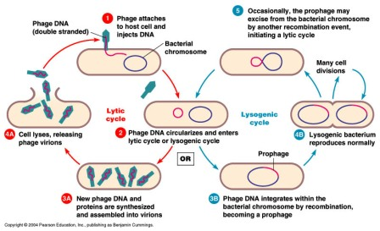
Bacteriophage life cycle

Slide 299
Life Cycle cont’d
When a bacteriophage infects a bacterium, it gets attached with the bacterial cell by its tail.
The tail secretes proteolytic enzymes that make a hole in the bacterial cell.
The DNA of the head is injected into the bacterial cell.
The protein coat remains outside the cell.

Slide 300
Life Cycle cont’d
The phage DNA inside the bacterial cell start replicating by utilising precursor substances from the host cytoplasm to form its own progeny (such a phage is called virulent phage) or becomes integrated into the host chromosome as prophage and replicate in synchrony with the bacterial chromosome (such a phage is called nonvirulent or temperate phage).

Slide 301
Life Cycle cont’d
Each copy of the DNA is enclosed by a protein coat, producing a new bacteriophage.
The host cell containing the virulent phage soon bursts, releasing hundreds of new viral particles.
The new viral particles may repeat the same cycle.
The virulent phage thus destroys the host cell.

Slide 302
Life Cycle cont’d
The temperate phage does not destroy the bacterial cell.
Rarely, a bacterium containing a temperate phage will lyse liberating many infectious viral progeny.
As the host cells are potentially subject to lysis, they are called lysogenic.

Slide 303
Life Cycle cont’d
A virulent phage may remain in quiescent for a long time but may convert into reproductive virulent phage by some radiation sources (such as ultra violet or X-rays) and disrupt the bacterial cell.
Virulent phages cannot become prophages. They are always lytic.

Slide 304
Life Cycle cont’d
Temperate phages can integrate into bacterial chromosome as prophages , allowing the host cells to survive in the lysogenic state.
Prophages occasionally exit the bacterial chromosome and enter the lytic cycle.

